Slide 1
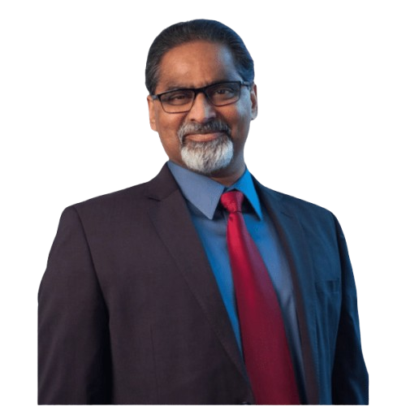
Gopi ShasthiPoorti 60th birthday July 30th, 2025
Notes:
Welcome to Gop’s Shasthipoorti. Shasthi is 60 and poorthi means completion. This is a Sanskrit term.
Gopi as a baby to Gopi today as a founder of SAAK

Slide 2
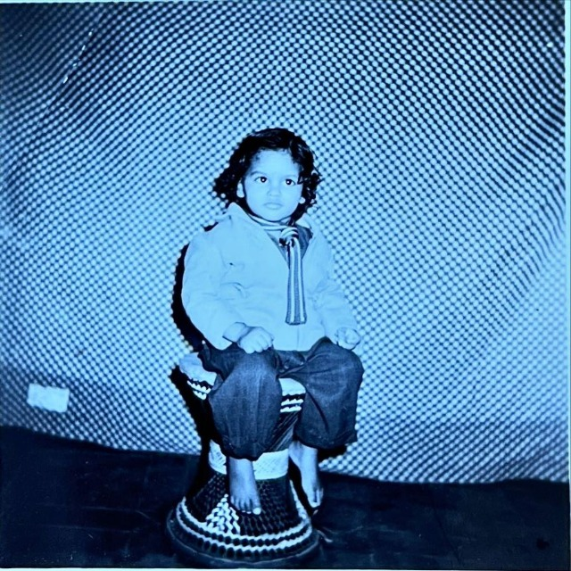
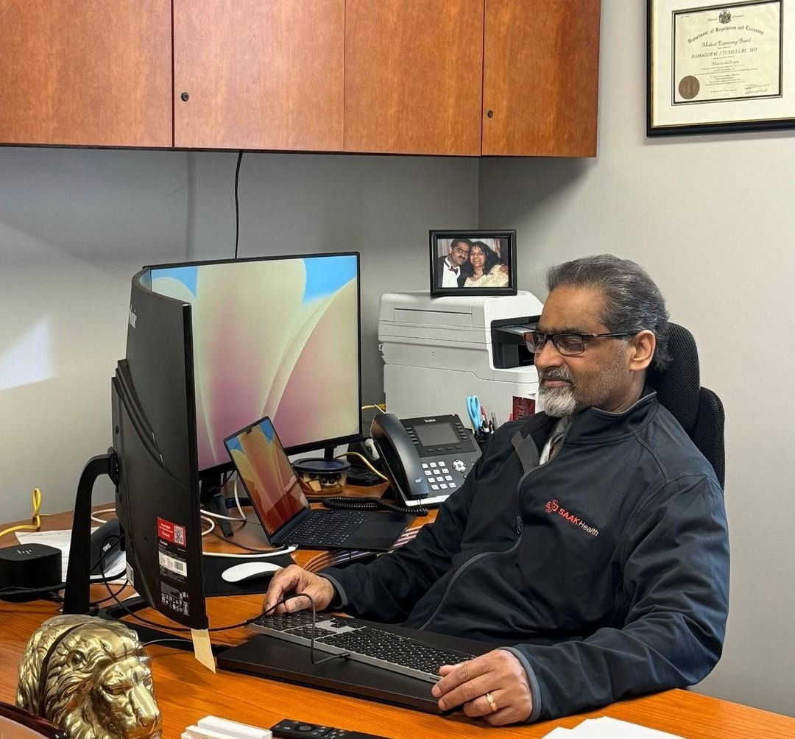
60 years
Notes:
Welcome to Gop’s Shasthipoorti. Shasthi is 60 and poorthi means completion. This is a Sanskrit term.
Gopi as a baby to Gopi today as a founder of SAAK

Slide 3
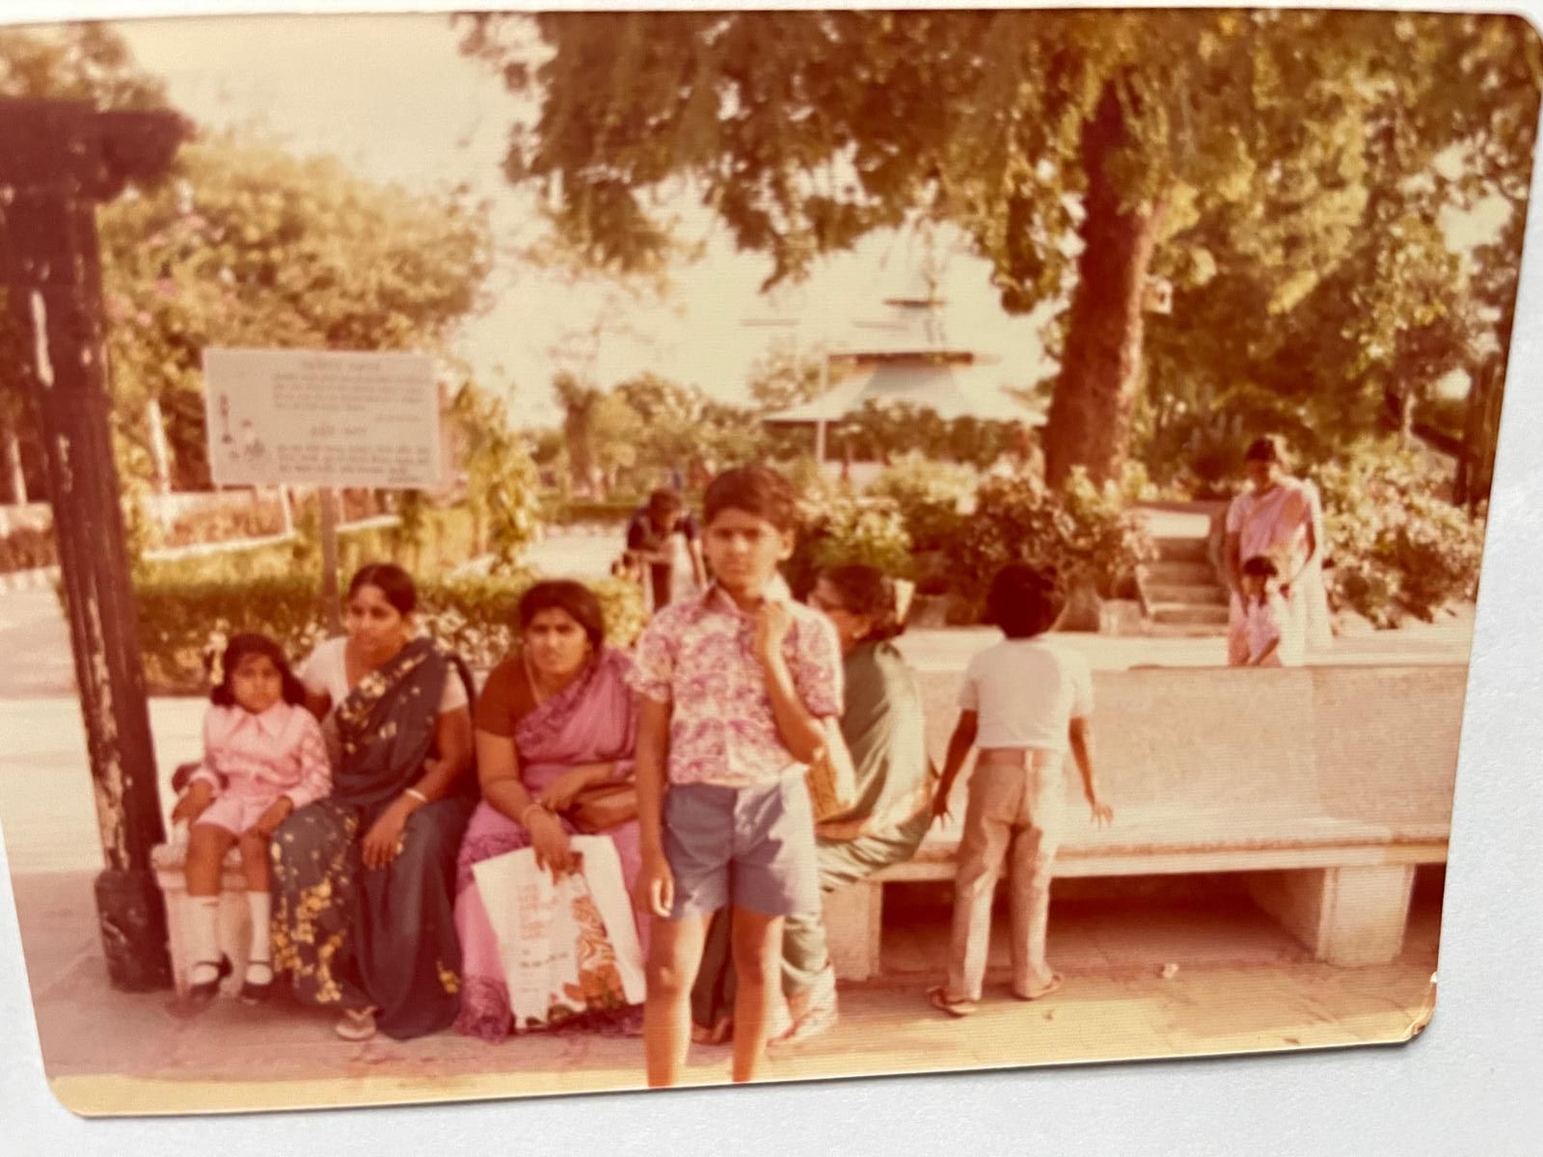
Living life on his own terms (Hyderabad – 1972 )

Slide 4
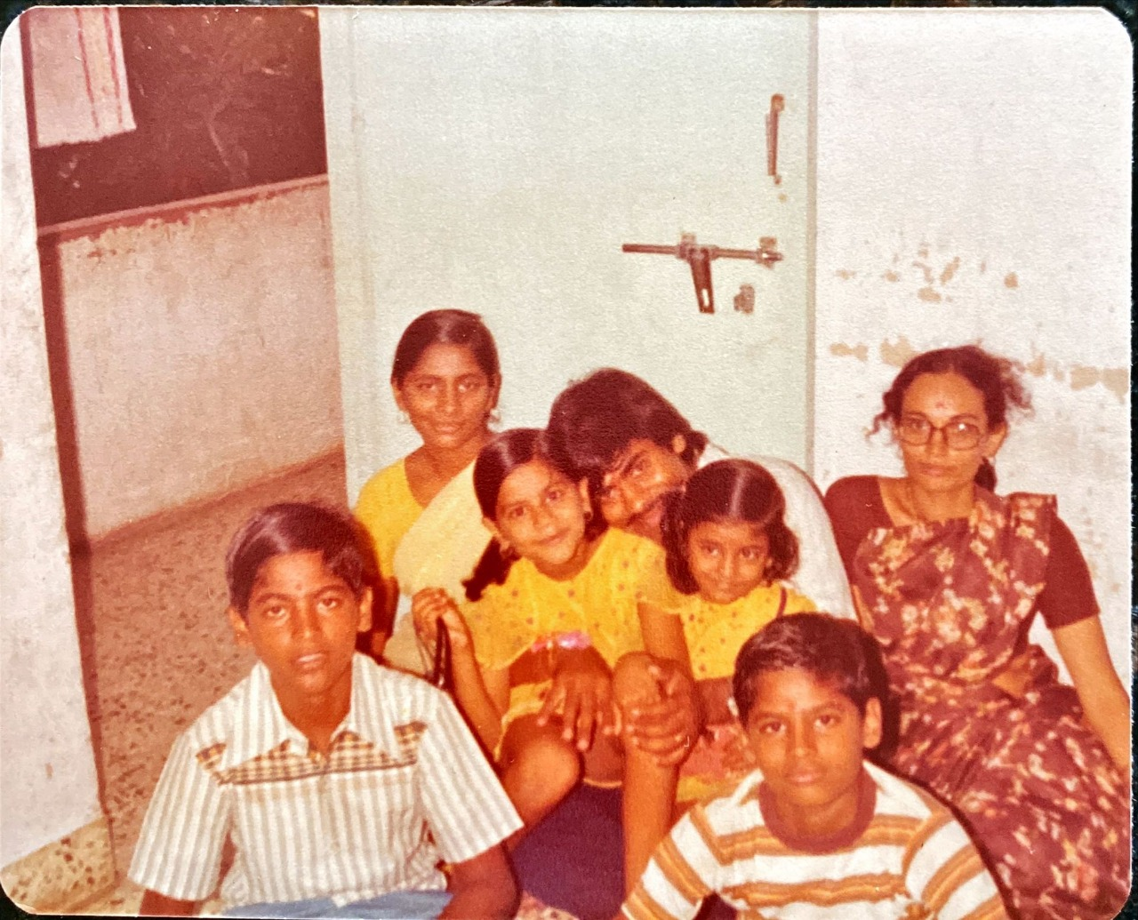
Living life on his own terms – Ahmedabad 1977

Slide 5
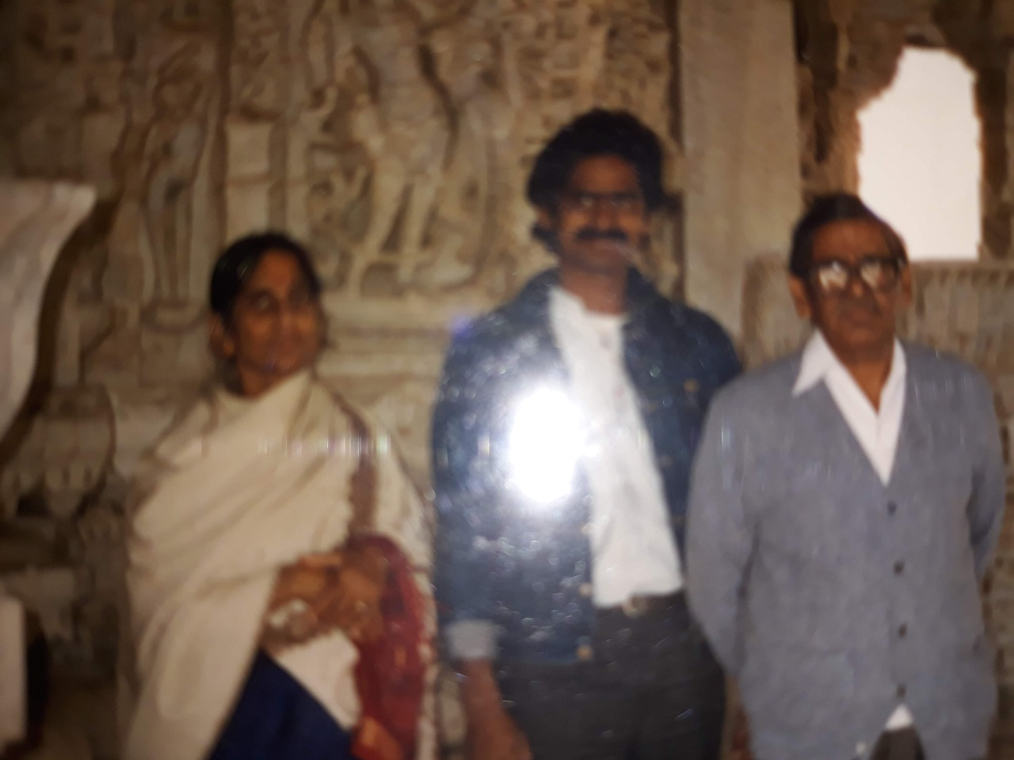
Living life on his own terms – BJ Medical College – Ahmedabad 1980’s

Slide 6

Living life on his own terms – SAAK – Brookfield, Wisconsin 2024

Slide 7
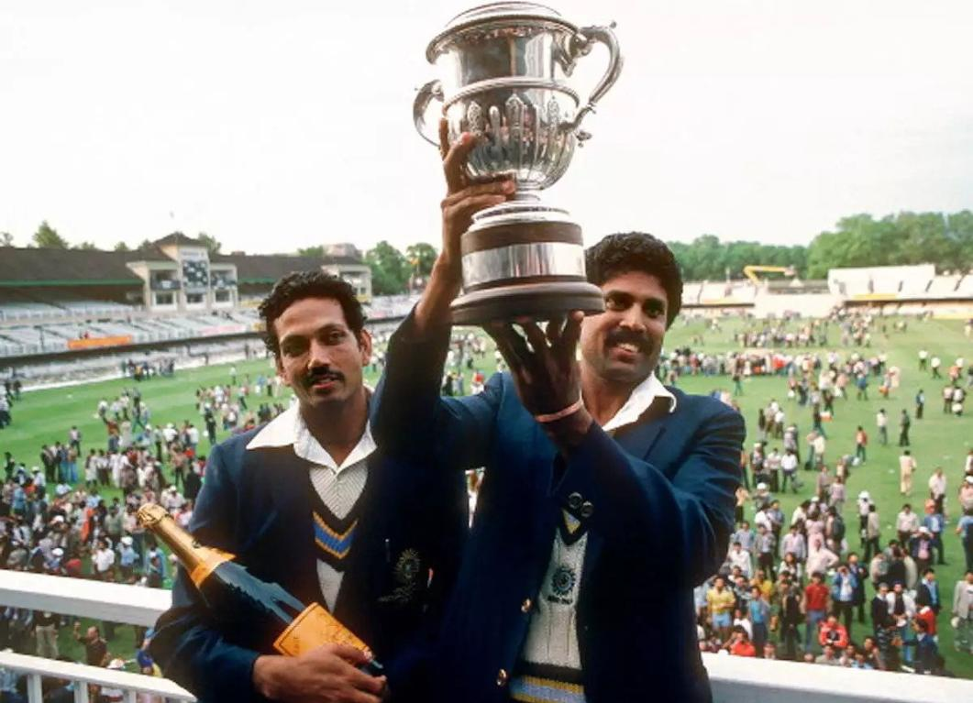
Large hearted – 1983 Cricket World Cup

Slide 8

Large hearted – Chinmaya Mission

Slide 9

Large hearted – Sanjivani hospital, Kuchipudi

Slide 10
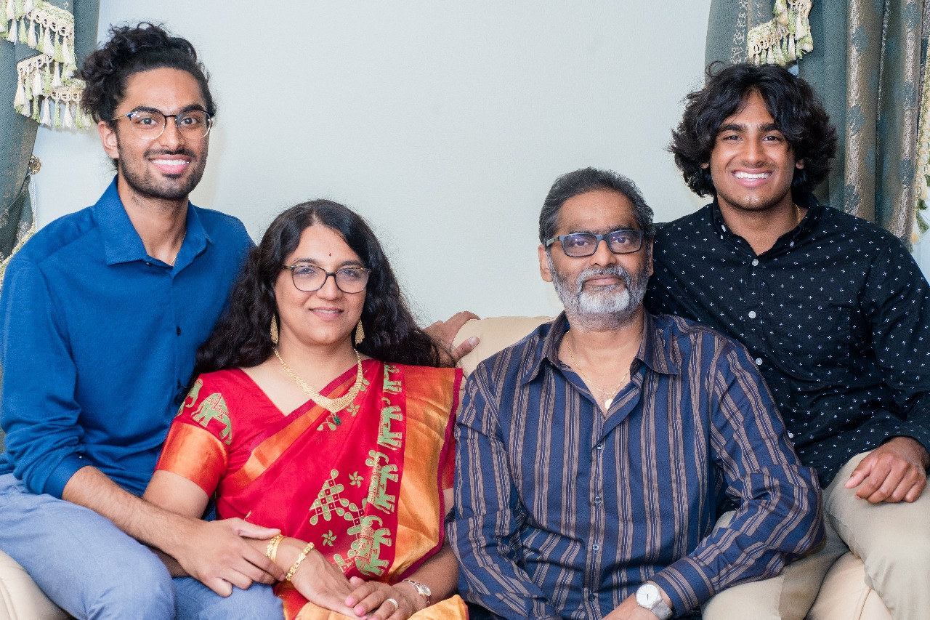
Friends / Family – Commitment, Loyalty

Slide 11
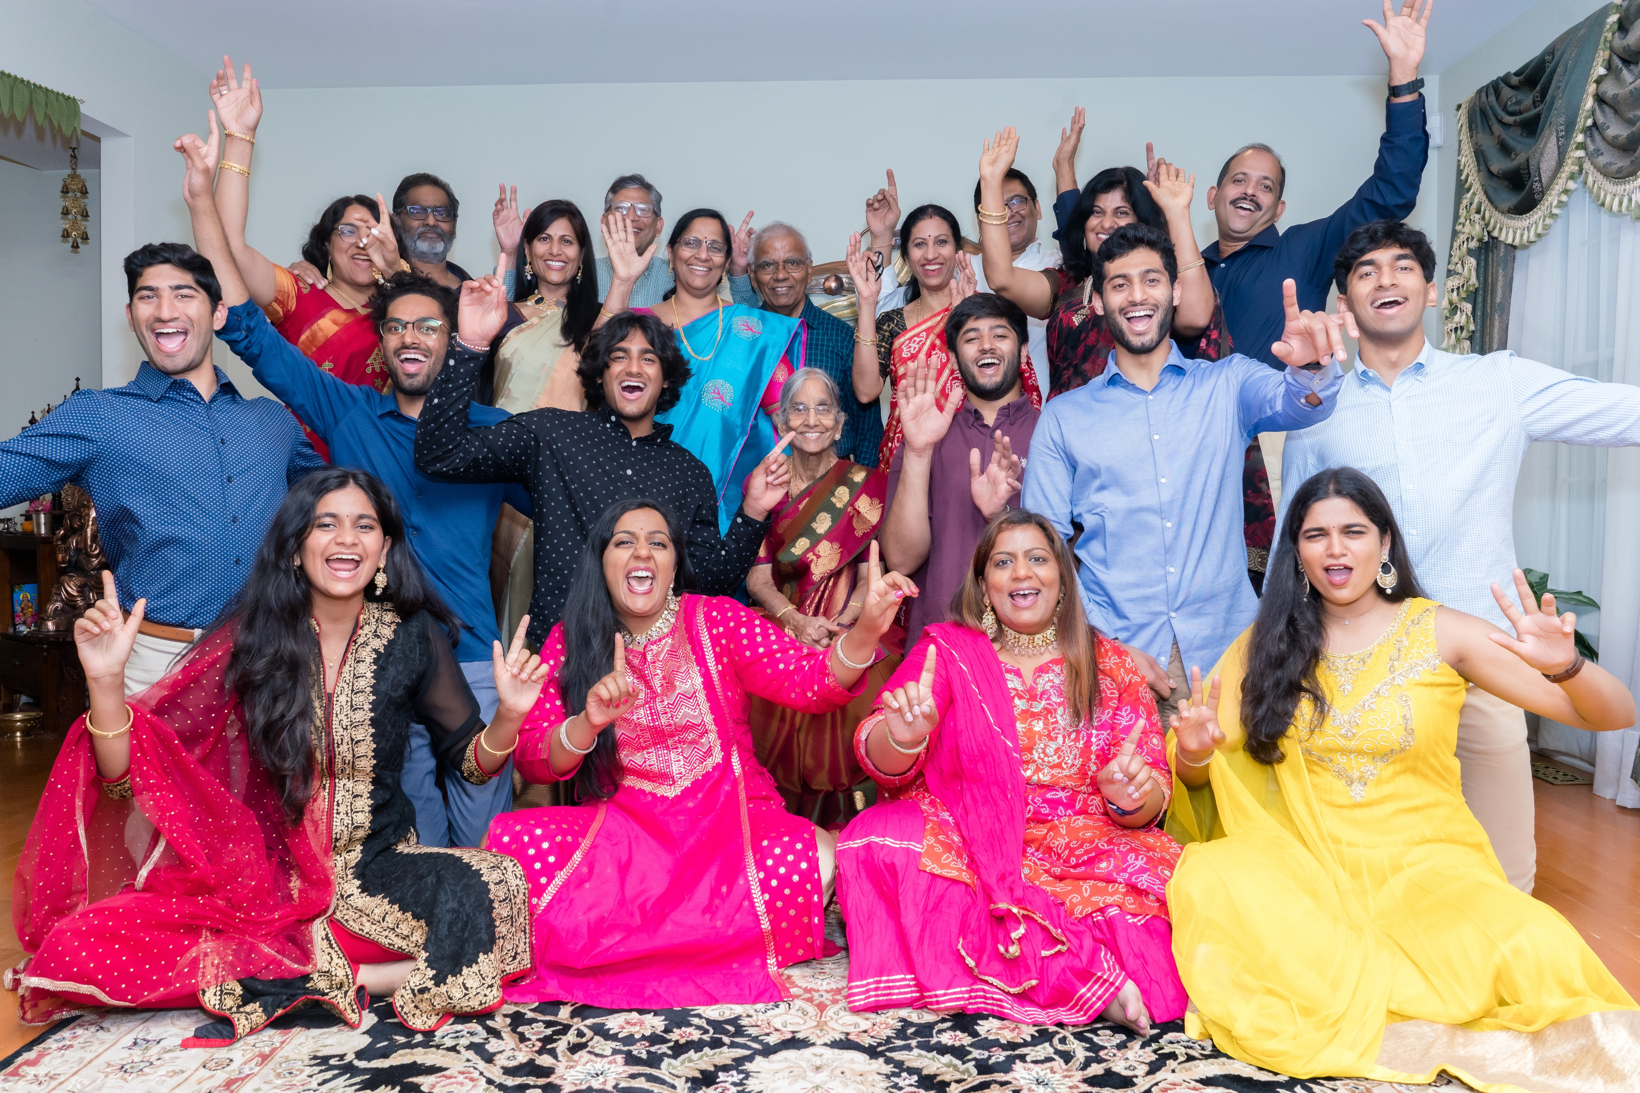
Friends / Family – Commitment, Loyalty

Slide 12
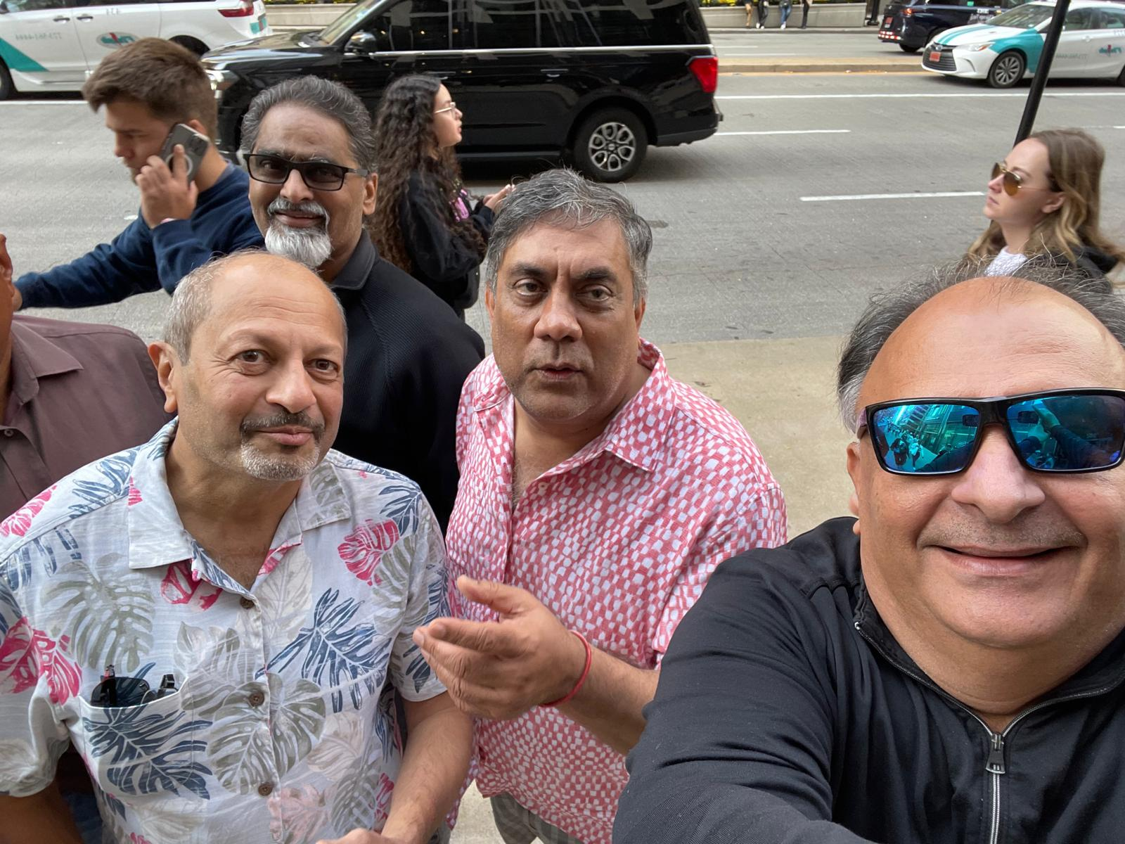
Friends / Family – Commitment, Loyalty

Slide 13
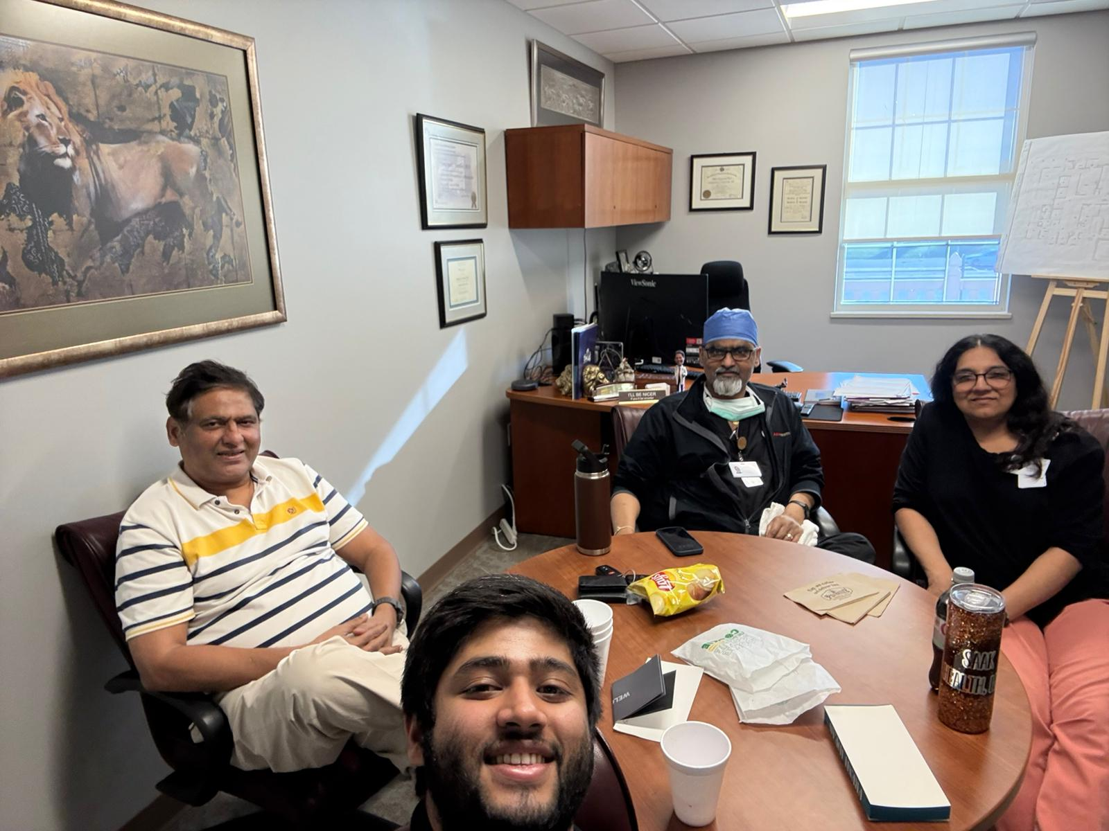
Friends / Family – Commitment, Loyalty

Slide 14
Living life on his own terms
KV – Uppal, Abad
Study in tents
Hand me down books
Own games – Plants, Chain, Swing, Volleyball
BJMC
Unique experiences
SAAK
Courage to re-start
Climb mountain

Slide 15
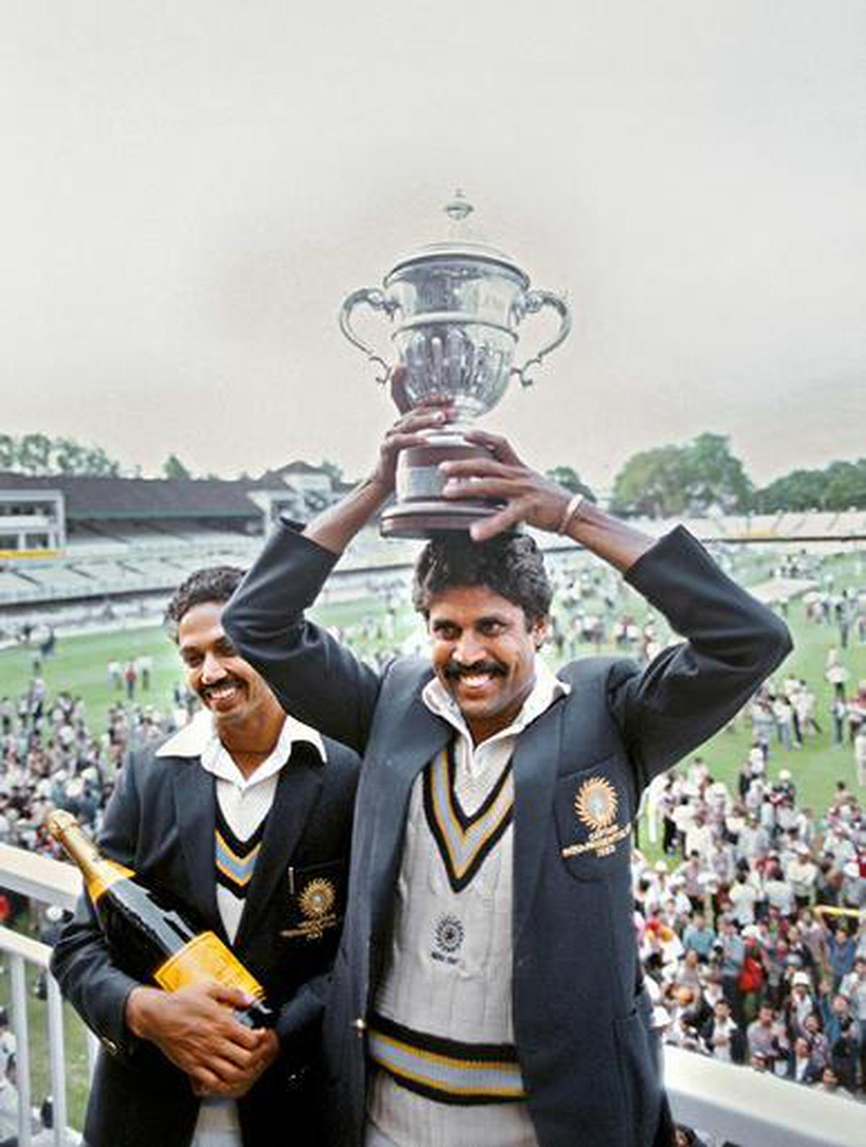
Large hearted
1983 world-cup Sports magazine
Chinmaya Mission, Chicago
Sanjivani hospital, Kuchipudi, Krishna Dt, AP, India

Slide 16
Gopi’s Duniya …
Family
Jeevansathi Suman, Aakash, Saahil.
Extended family
Friends
Jayesh, Vinit
Chela
Chaitan
USMLE, Fellowship

